Slide 1
We are the Cost Reduction Experts
Consultant Name
Schooley Mitchell Title

Slide 2
Industry Insights
On average, organizations spend 35% more than they need to on business services
In a recent survey, the majority (81%) of participating companies had errors on their telecommunications bills
Organizations spend up to 15% of their operational costs on telecommunications and merchant processing fees and lack both the time and special tools to optimize

Slide 3
Constant Evolution
A Complex Industry
Services
Our Offering
Credit and Debit Card Processing
Small Package Shipping and Courier
Waste Disposal
Local Phone Services
Long Distance
Wireless Devices
Internet
Conferencing
Data Connectivity
Electronic Logging Devices
eSignature Services
Numerous rate plans, tariffs, contracts, promotions, bundles
Thousands of disparate billing systems
Extensive billing errors
Continual technology changes
Mergers, acquisitions, bankruptcies
Constant change among vendors
Regional differences
Ongoing optimization of telecom services, such as landline, long distance, wireless services, data, internet, conferencing & more
Merchant services analysis, including credit card, debit card, eCheck & ACH transactions
Small package shipping & courier cost reduction and service optimization
Waste expense management, including disposal optimization
Electronic Logging Device (fleet tracking) expense optimization
eSignature service expense optimization
Utilities and Fuel expense optimization
Billing error identification and recovery
Project management, needs analysis, technology recommendations
Assisting with hardware upgrades & installs, office relocations, network integration
Incur no expenses, no internal resource requirements, and mitigate risk
Client is always in charge of the go/no-go decision
If there are no savings there is no fee
90% of clients reduce expenses by more than 18%
Average savings is 28%
80% never have to change vendors

Slide 4
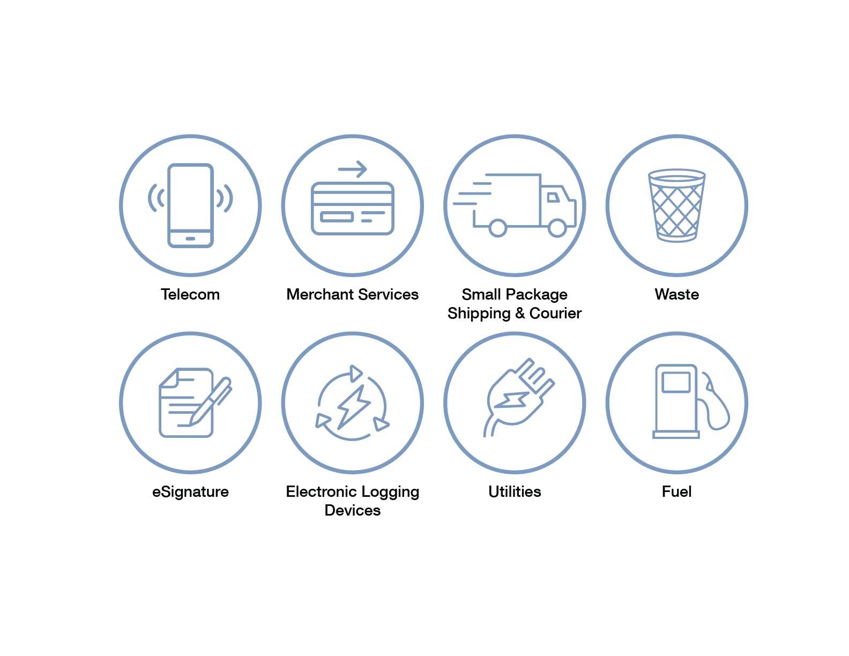
Services
We are completely independent of all service suppliers and solely look out for your best interests with objective advice
Our clients reduce their various business expenses by an average of 28%
Over 26,000 clients
$540 million in documented savings delivered to clients
Specialized software, benchmarking tools, best-in-class pricing databases
Independent and objective
Focused, experienced and skilled
Fees earned by saving money for clients

Slide 5
Approach to Operational Savings
Service Agreement and Letter of Agency allowing us access to billing history, equipment records and volumetric data
Step 1
Step 2
Provide an accurate total cost of ownership. Benchmark to clearly establish vs. best market pricing
10+% Cost reduction
Step 3
Leverage technology to determine errors vs. contract and customer service records, analyze all features to determine ideal load balance customized to your operating model.
10+% Cost reduction
Deliver a Value Report with a detailed Current State and improved Future State recommendations. 80% of customers stay with current provider.
Incremental
Step 4
Step 5
Drive performance and process enhancements with ongoing analytics. Analyze how communications are used as an operational asset and provide a quarterly audit.
Incremental
Notes:
Xerox Overview – August 2015

Slide 6
Methodology and Value Levers
Value | Internally Manage Costs | Vendor Manage Costs | Schooley Mitchell Manage Costs
Knowledge of current costs | √ | √ | √
Knowledge of market alternatives | √ | ? | √
Independently and objectively evaluate marketplace options | √ |  | √
Specialized analysis tools to optimize costs |  |  | √
Best-in-class pricing database for comparison of all vendors |  |  | √
Negotiating clout from representing 26,000+ clients |  |  | √
R&D department focused exclusively on rapid changes in marketplace |  |  | √
Time to review costs, alternative, negotiate, summarize & recommend | ? |  | √
Time to audit bill & options monthly |  |  | √
Direct access to vendor personnel |  |  | √
Motivated to continually reduce costs | √ |  | √
Access to 325+ consultants |  |  | √
Notes:
Xerox Overview – August 2015

Slide 7
Engagement Model
Executive sponsorship
Authorize SA & LOA
Define Value Report review date
Select best suited option
Implement
ASSESS
VALUE
REPORT
APPROVAL
VENDOR
AGREEMENT
IMPLEMENT
&
AUDIT

Slide 8
We are the Cost Reduction Experts
Consultant Name
Schooley Mitchell Title
Phone Number
email@schooleymitchell.com

